Slide 1
A Gravity Control in action example
Sorting articles related to the intellectual property containing APPLE, NOKIA, SAMSUNG, HTC and ANDROID, collected to Gravity from Google News and Bing Search API
Starting search criteria – PATENT, APPLE and NOKIA
Demonstration of the different ways of searching, sorting and managing information with Gravity Control
More details in the Video section of the website and in the Developers Help Notes document
Notes:
In order to visualize the previous scheme, an example in specifics will be demonstrated.

Slide 2
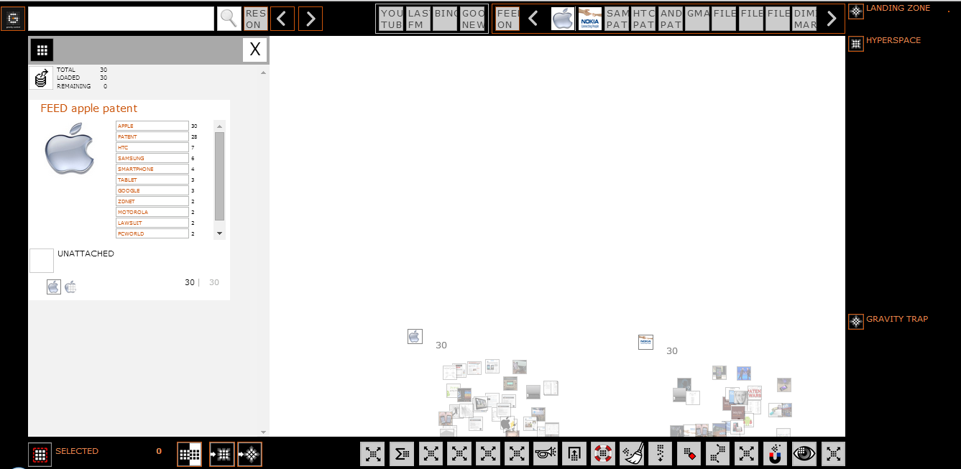
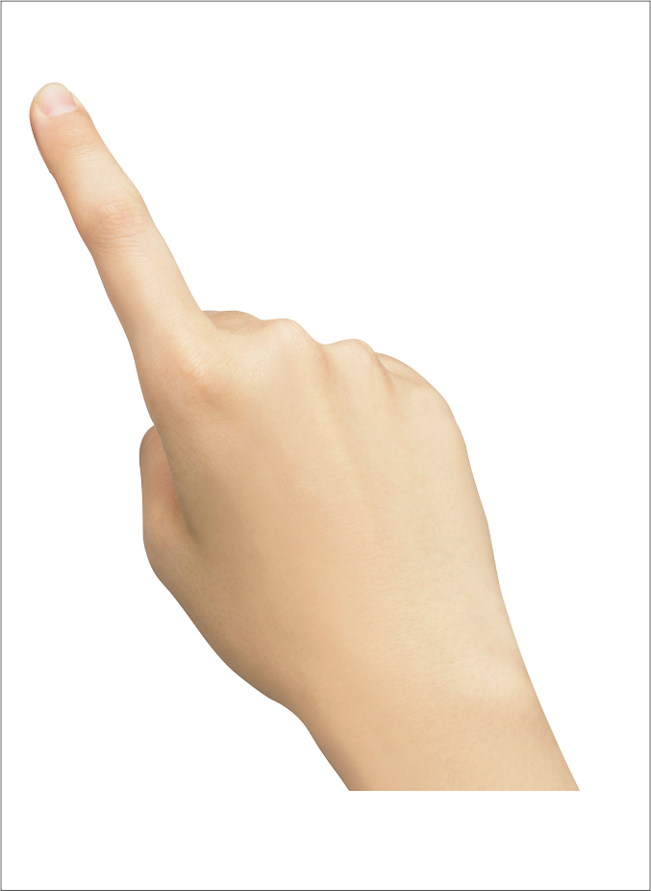
Search by example – loading objects on the workSPACE
APPLE ARTICLES
FEED
NOKIA ARTICLES
FEED
APPLE ARTICLES
Notes:
For starters, create some “chaos” in the workSPACE by loading feeds onto it. In this case – these are the feeds APPLE PATENT, HTC PATENT, NOKIA PATENT.

Slide 3
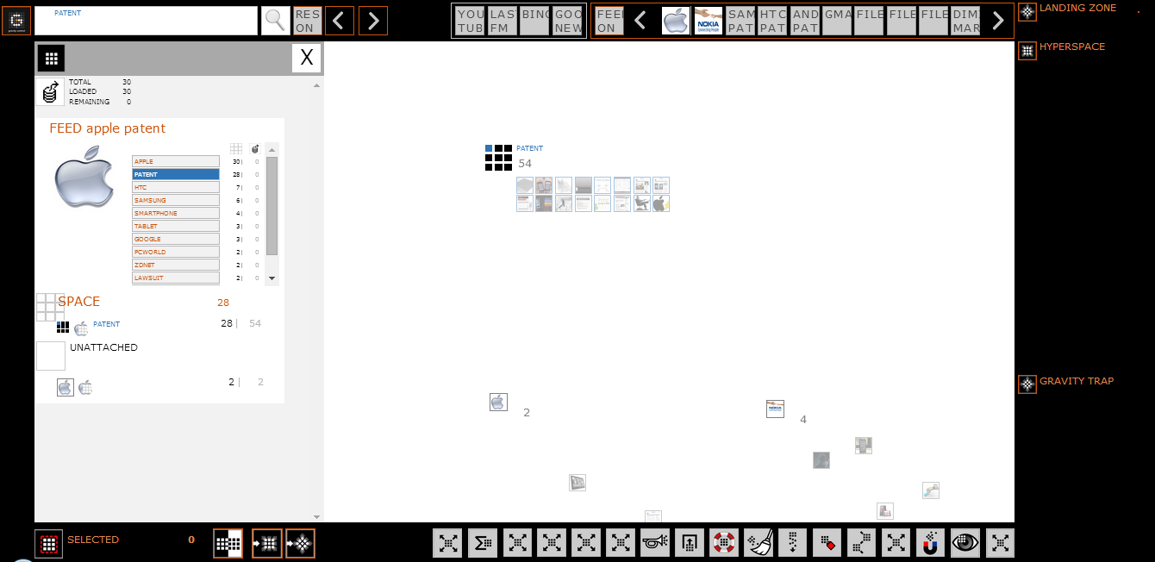
Search by example – choosing an object of interest and extracting criteria
“PATENT“
ATRIBUTE EXTRACTED
ARTICLE DETAILS
Notes:
Find some „sense” by browsing through the objects and their properties (attributes)
In this case: an object from the APPLE PATENT feed is selected and the attributes “PATENT” and “APPLE” from its list of attributes are being dragged out onto the workSPACE as search criteria.

Slide 4
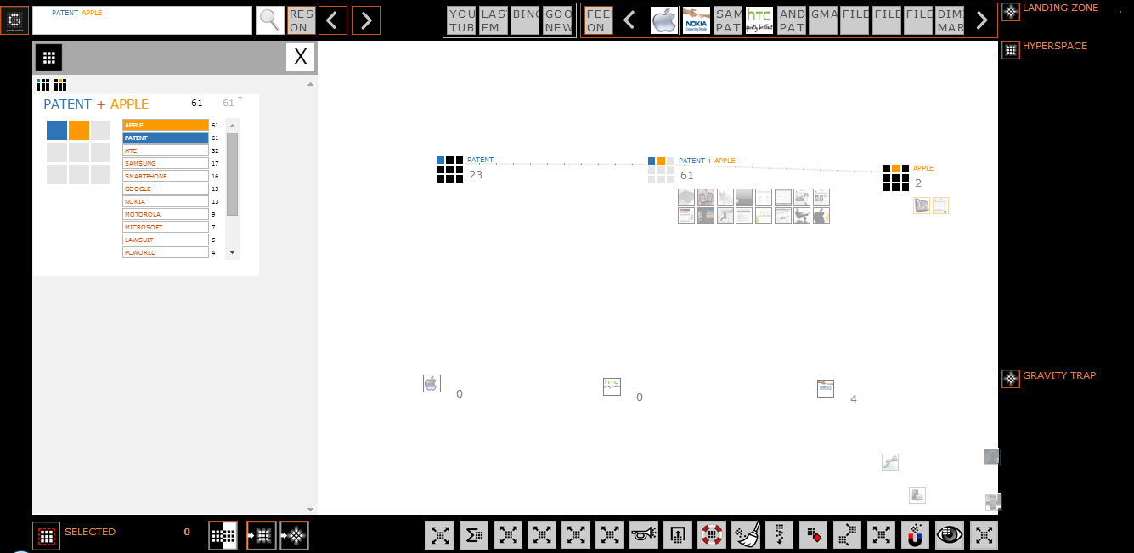



Grouping similar objects together
“APPLE“
ARTICLES
“PATENT“
ARTICLES
“PATENT“+“APPLE“
ARTICLES
NOT RELEVANT
Notes:
Once the grouping criteria are dragged out onto the SPACE the “grouping” automatically starts and all elements from the currently loaded feeds, which correspond to those criteria, are distributed in the respective grouping points.

Slide 5
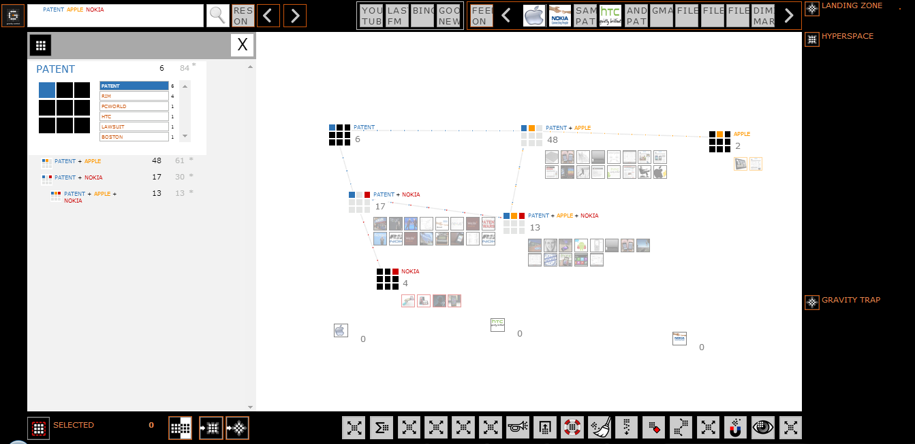
Simultaneous sorting by multiple criteria
Redefining the search by adding more grouping points:
“NOKIA”, etc.
Notes:
Increase either the “sense” by redefining the search…
(In this case: adding a third criterion – “NOKIA” onto the workSPACE)

Slide 6
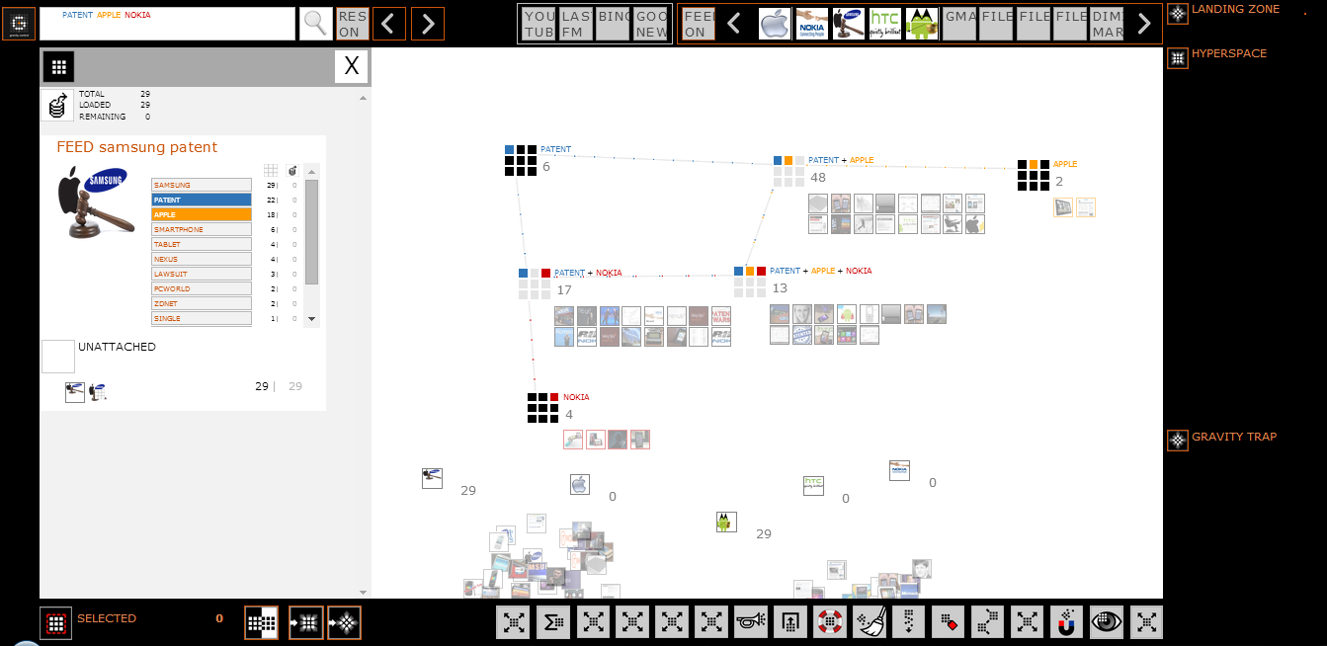

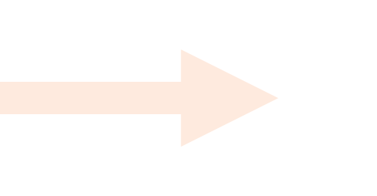

Adding files for an expanded search
Expanding the results by adding more objects to defined grouping points:
SAMSUNG ARTICLES FEED, ANDROID ARTICLES FEED, etc.
Notes:
Or the “chaos” by adding more files in the workSPACE.
(In this case: adding SAMSUNG PATENT and ANDROID PATENT feeds onto the workSPACE)

Slide 7
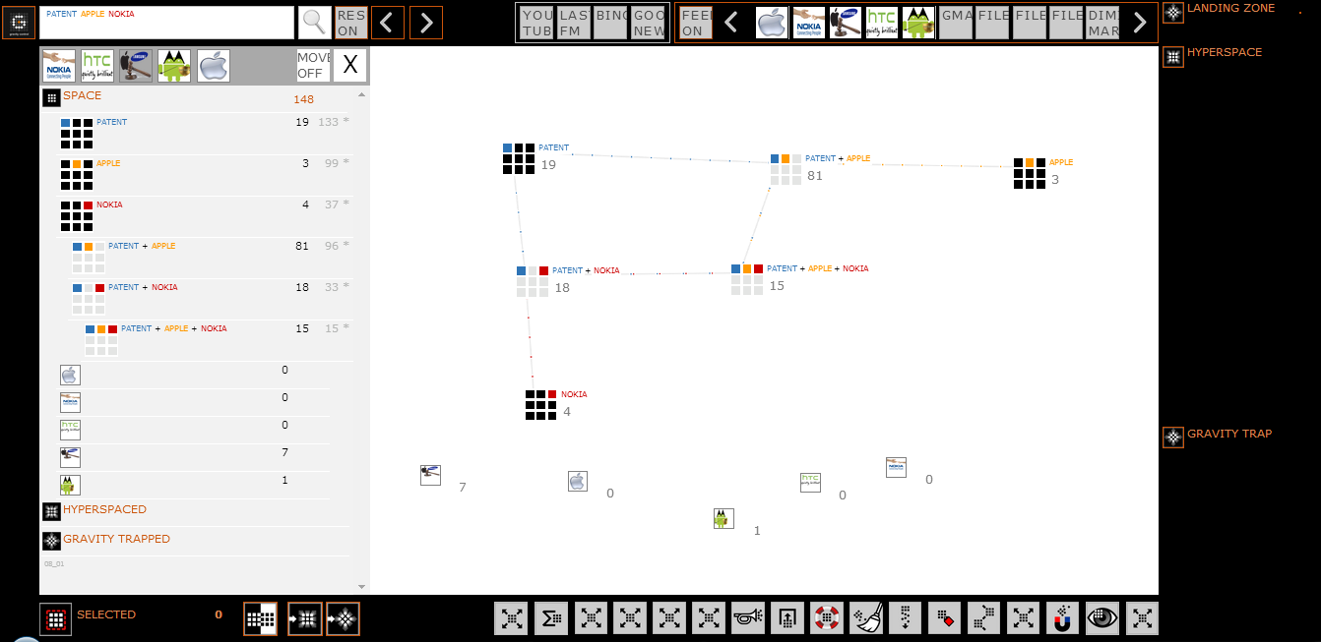
Performing further actions
(
MOVING
“PATENT“+“NOKIA“
ARTICLES TO HYPERSPACE
FOR FURTHER ACTIONS
Notes:
Dragging the PATENT+NOKIA group to the Hyperspace for further handling.

Slide 8
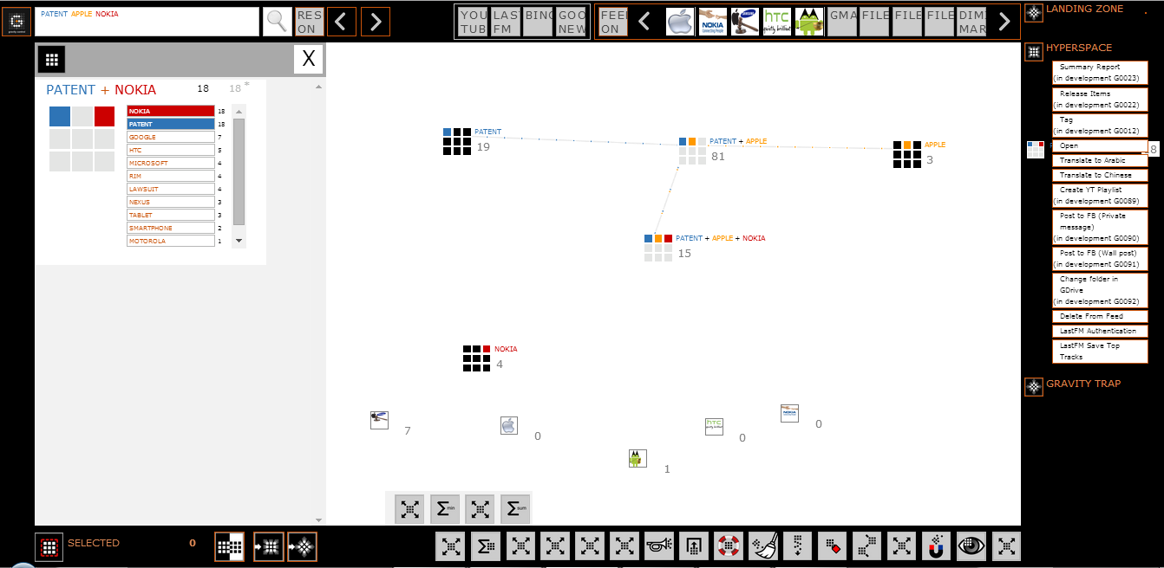
Performing further actions
Performing ACTIONS
on HYPESRSPASED objects
Such as:
OPEN
SEND
SAVE to GOOGLE DRIVE
POST in FACEBOOK
CREATE YOUTUBE PLAYLIST
TRANSLATE
CREATE XLS or PDF REPORT
Notes:
Heading to the Hyperspace specific operations and selecting “Open” to view the objects that have just been moved there in the browser

Slide 9
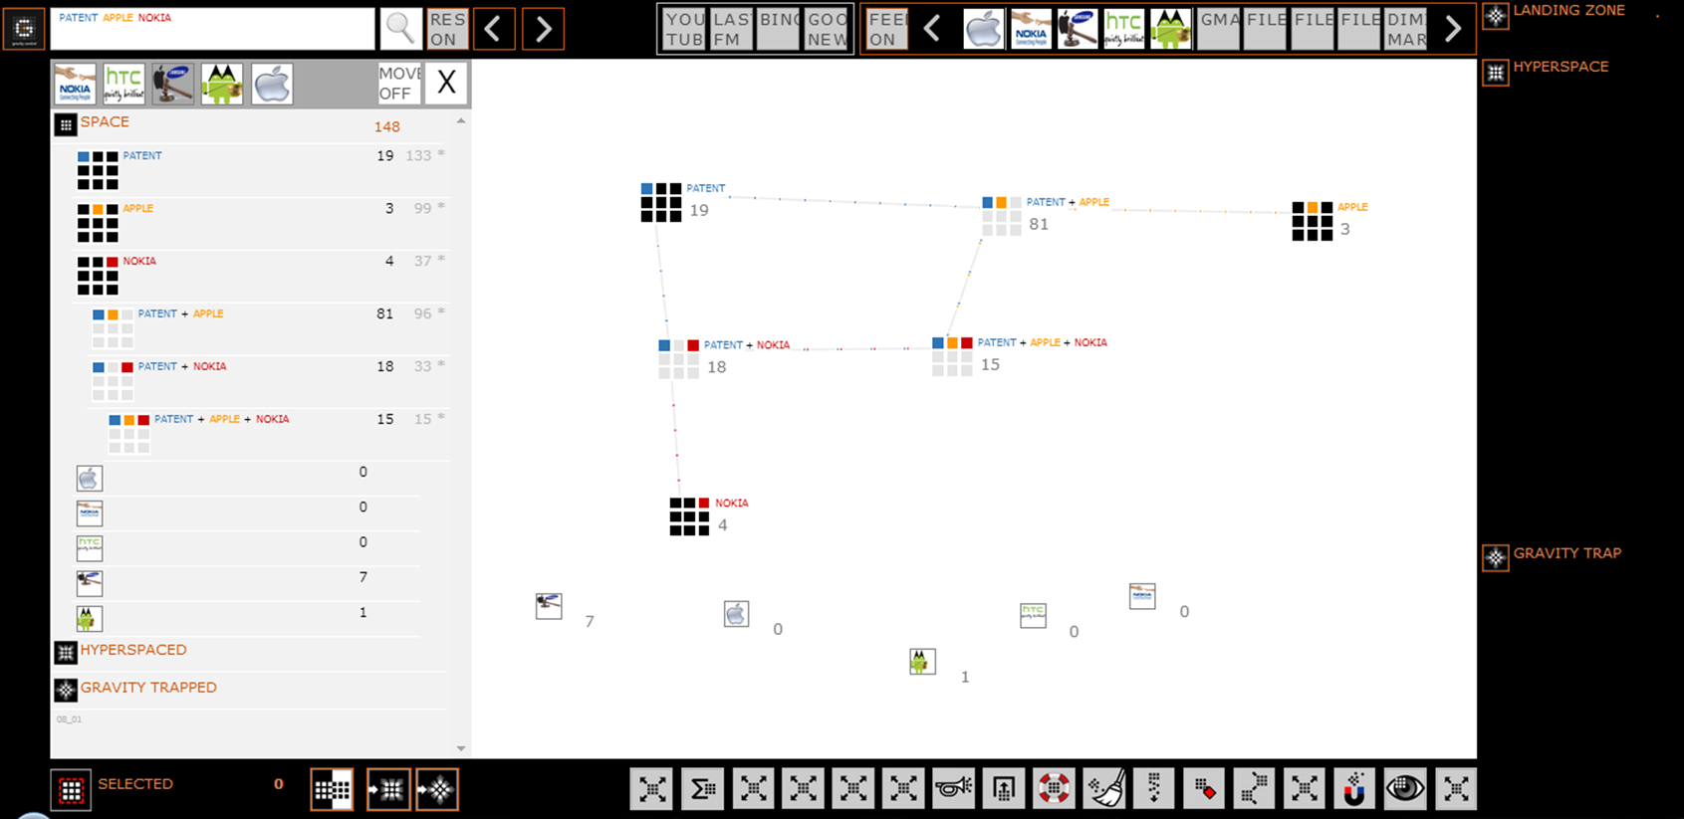

Gravity Impact– performing actions on a Grouping Point
GRAVITY IMPACT
Generating Report by Dragging “REPORT” action to
“PATENT” grouping point
Notes:
Operation buttons are dragable and can be dropped on any single object or group of objects.

Slide 10
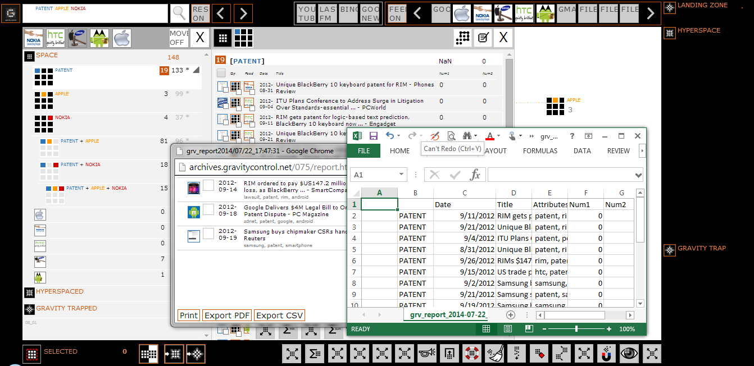
Import, Export and Reports
LANDING ZONE INPUT:
EXCEL
RSS
WEB Video Extractor
URL Crawler
etc.
EXCEL compatible OUTPUT
EXPORT to PDF, CSV, etc.
Notes:
Using Gravity internal report feature to view an exported report in either CSV or PDF formats or to select files and send them to either the Hyperspace, the Gravity trap or just perform an inverse operation – meaning unselect the currently selected and select all the rest of the loaded objects.

Slide 11
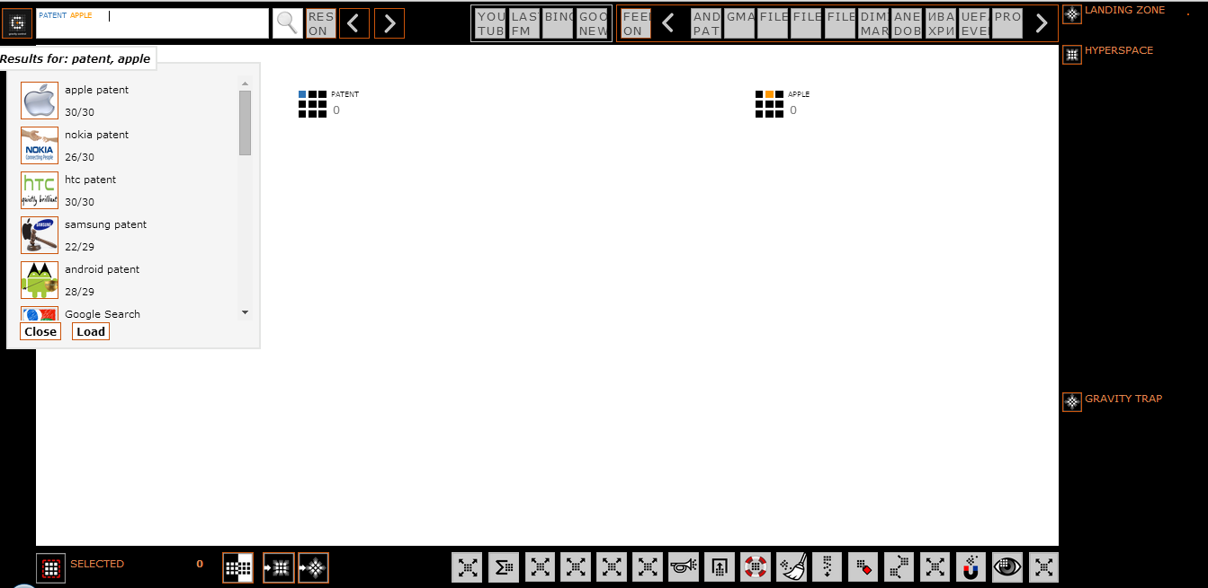
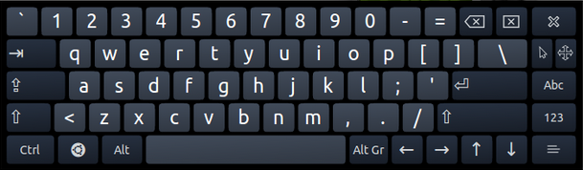
The currently common way of searching – the search bar
“OLD WAYS ARE THE BEST”
Entering the search criteria by the keyboard into the search bar is available
Notes:
Using the search bar approach – input PATENT and APPLE as search terms in the search bar textbox and hit on the spyglass. If the RES ON is active – the Feed Results Control Panel is displayed and the user can freely choose to load either all the files or some of them.

Slide 12
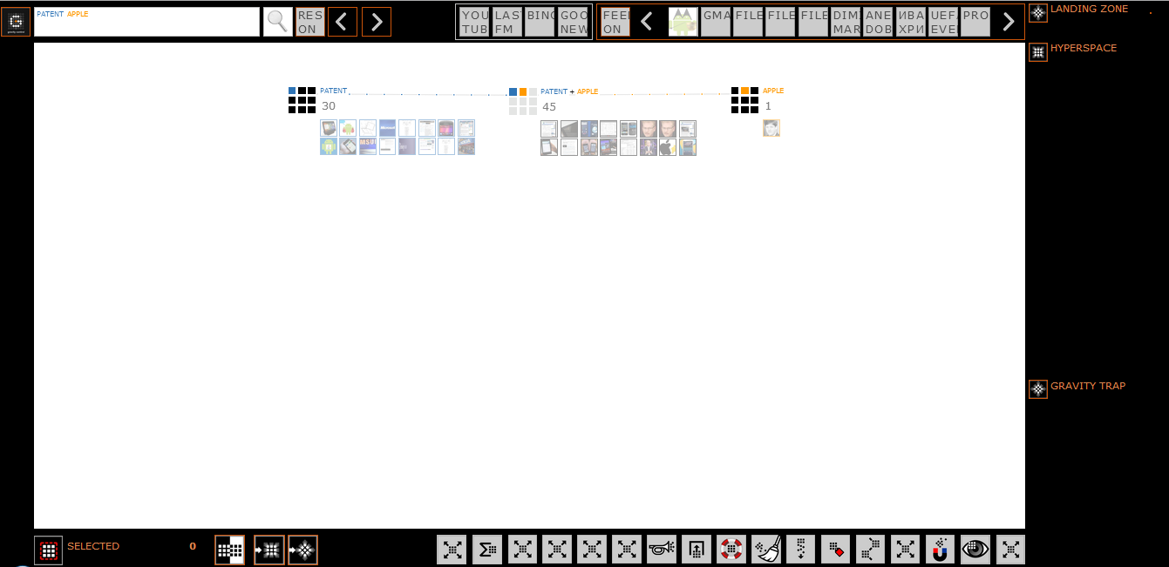
The currently common way of searching – the search bar
SAME RESULTS SAME VISUALISATION BY
TOUCH
MOUSE
PEN
KEYBOARD
Notes:
After pressing the “Load” button all objects (from all available feeds) corresponding to the input criteria start loading onto the workSPACE.

